Slide 1
Attending College 2023 - 24
Harris Academy

Slide 2
Logistical Information You Need
Bus Times Monday & Wednesday
Bus Times Tuesday & Thursday
You must be in the queue outside the plaza at 1.20pm
The bus leaves at 1.30pm sharp
TUESDAY – same as Monday and Wednesday
Thursday
You must be at the Plaza for 12.30pm
The bus leaves at 12.45pm sharp

Slide 3
MONDAY |  |  |  |  |  |  |  | TUESDAY |  |  |  |  |  |  |  | WEDNESDAY |  |  |  |  |  |  |  | THURSDAY |  |  |  |  |  |  | FRIDAY
1 | 2 | 3 | 4 | 5 | 6 | 7 |  | 1 | 2 | 3 | 4 | 5 | 6 | 7 |  | 1 | 2 | 3 | 4 | 5 | 6 | 7 |  | 1 | 2 | 3 | 4 | 5 | 6 |  | 1 | 2 | 3 | 4 | 5 | 6
S5&6 |  | C* | E | D* | B | B | A | A |  | E | E | B | B* | A* | C | C |  | B | E | E | D | D | A | A |  | E | B | D | D | C | C |  | A | D | C | CORE | CORE | CORE
S4 |  | M/E/PE | M/E/PE | SE | B | B | A | A |  | G | G | B | E/M/PE | E/M/PE | C | C |  | B | F | G | D | D | A | A |  | F | B | D | D | C | C |  | A | D | C | M/E | M/E | E/M
Column A (Monday & Wednesday)
64 pupils
39 - S5 & S6
25 - S4
Column C (Tuesday & Thursday)
15 pupils
8 - S5 & S6
7 - S4
You work additional hours going to college
Options for you
Column C – start at 9.35am on a Monday for S5 and S6 pupils only
Column A – double lunch on a Tuesday for S5 and S6 pupils only
Column A – start at 9.35am on a Friday S4, S5 and S6 pupils
I will send a Microsoft Form link to your email and you must complete it in full to allow me to manage your options.
This is a trial for June to see if you can make it work

Slide 4
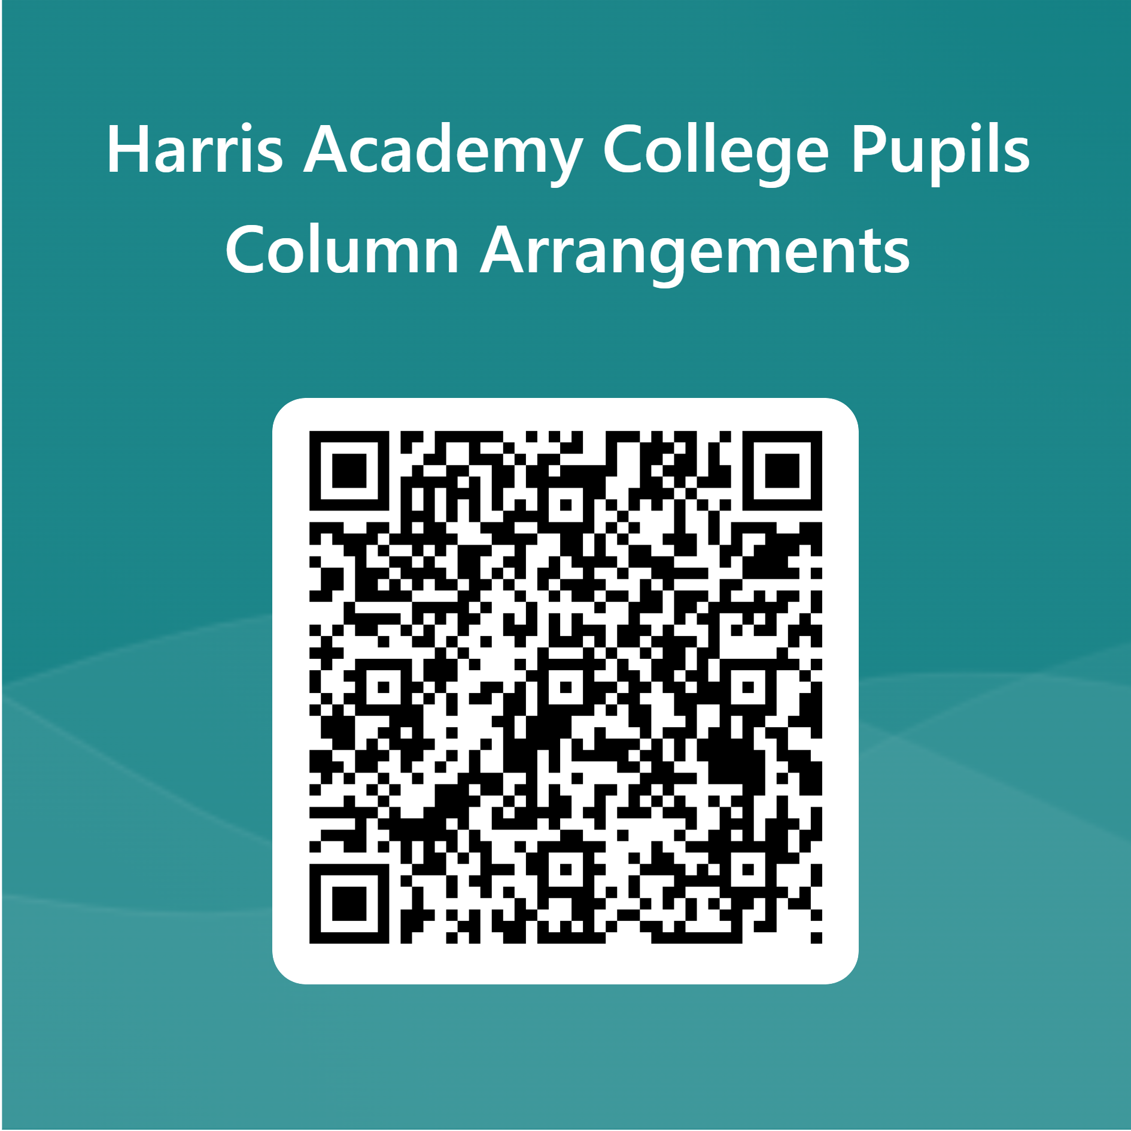
https://forms.office.com/Pages/ResponsePage.aspx?id=8ivvw5gTK0G4l47RiS-LjWZ_ZO3ZLIJDk91H9rrSPS1UM0JVV0xXMEtOQjJSWVJXOTRVMDdTVEo5TC4u

