Slide 1
Spanish Higher
Listening Study Pack

Slide 2
La tecnología
Listen to 4 people talking about how they use technology and make notes in English.
1.
2.
3.
4.

Slide 3
Internet
Listen to 4 people talking about different types of technology and note:
What they are comparing
Their opinions

Slide 4
Los jóvenes españoles y el tiempo libre
Listen to this radio report on young Spanish people and their free time and answer the questions.
How many young people took part in this survey?
What age group were these people?
Mention 3 other popular pastimes of young people.
What do 5 out of 10 people admit to?
Where do young people get their music?
What do 82% of people do?

Slide 5
¿Qué haces en tu tiempo libre?
Listen to Julián talking about what he does in his free time and answer the questions in English.
1. What sport does Julián prefer?
2. What other sports does he enjoy?
3. What things does he not enjoy doing?
4. What else does he like to do in his free time?
5. What does he say about his computer?
6. What does he have to say about computers?

Slide 6
¿Qué puedo hacer?
Listen to these 6 people and match up the correct letters.
Si me hago voluntaria… (Silvana)
Si me hago miembro de Oxfam… (Mustafá)
Si apadrino a un niño del Tercer Mundo… (Gabriel)
Si reciclamos y reutilizamos… (Sabrina)
Si pago un poco más por los productos de comercio justo… (Juam Pablo)
Si educamos a la gente… (Isabel)
Mejoraré la sociedad, ayudaré a los demás y haré algo útil
Transformaremos el mundo y acabaremos con la pobreza
Tendrá la posibilidad de sobrevivir
Cuidaremos el medio ambiente
Más personas tendrán una vida digna
Los trabajadores tendrán mejores salarios

Slide 7
Voluntarios
Listen to Isabel and answer the following questions.
How long has she been a volunteer?
What sort of work does she do? Give 2 details.
What are the people like that she works with? Give 3 details.
Why did she sign up?
Who in particular would she recommend volunteering to?

Slide 8
Sin techo, sin derecho
Listen to an interview with Arantxa who used to be homeless and answer the questions.
What age is Arantxa?
How long ago was she homeless?
How did she end up on the street? Give 2 details.
What 4 problems did she see amongst the homeless?
Who helped her get off the street?
What does she do now?
Does she have plans for the future? Mention 2 details.
What is she concerned about?
What will she be happy to be doing?

Slide 9
Los idiomas
Listen to 4 people talking about their jobs and note the following:
What job they have done
How they used their languages

Slide 10
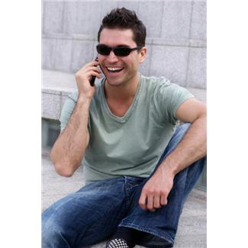
Planes para el futuro
Listen to Toni and Ana talking about their plans for the future and answer the following questions.
TONI (17)
Why does Toni want to leave school?
What career does he want to follow?
What will he do in his gap year?
What are his dreams for the future?
ANA (16)
What will Ana do next year?
And after that?
Where does she want to work?
What are her dreams for the future?

Slide 11
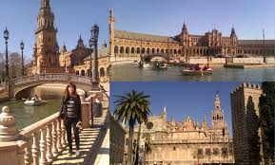
En Sevilla
Listen to Lola being interviewed about her visit to Seville and decide if the following statements are TRUE or FALSE:
Lola was impressed by the buildings in Seville.
She saw some of the city on foot.
On Wednesday she took a tour bus.
There was no guide on the tour bus.
The weather was too hot.
She ate snacks generally.
She is a vegetarian.
Her father ate pork.
She found the people in Seville very nice.

Slide 12
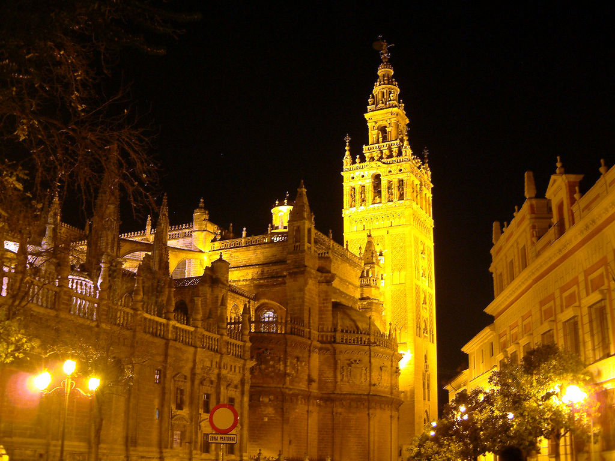
¡Vamos a Sevilla!
Listen to Pablo, Carlos and Isabel talking about visits to Seville and note whether their general opinion is POSITIVE or NEGATIVE. Then listen again and note their reasons.
PABLO
CARLOS
ISABEL

