Slide 1
Harris Academy DYW Weekly
22/02/21

Slide 4
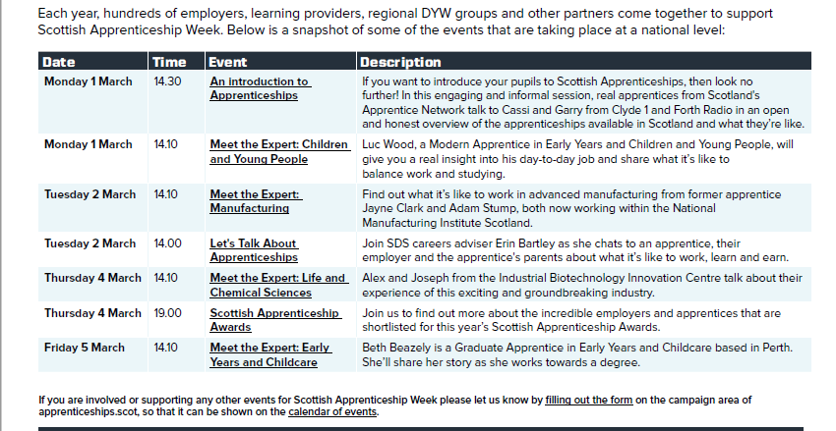

Slide 5
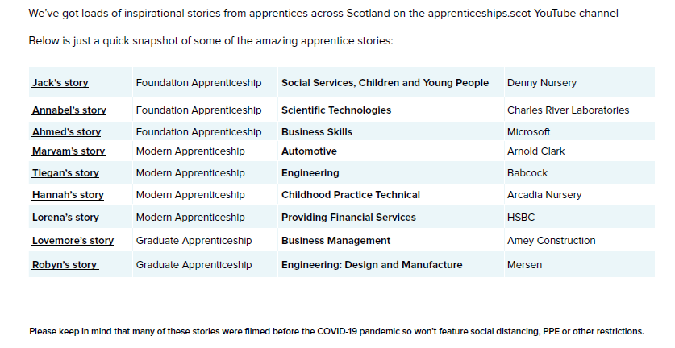

Slide 7
Tasty Careers
Healthy Careers
Energising Careers
The DYW network have been working on virtual careers to support young people during the lockdown
Resource packs for the following sectors have been developed. Feel free to explore the links opposite to find out more

Slide 8
Aims
To raise awareness of the diversity of careers in the food & drink, healthcare and energy sectors and how to access them
To enable young people to think about their subject choices in relation to pathways and make informed decisions
To showcase desirable skills to the industry and how young people can develop themselves
To support young people on their journeys

Slide 9
Not sure what you want to do after school? Follow the link below to the Career Inspiration films for each of these areas
DYW Scot website

Slide 10
My World of Work
The link above will help you discover careers which match your skills, interests, education and experience. Tell them about your ambition and they’ll help you find out how you can work towards it Find out what your strengths are, and how they can help you pick a career that will suit you
This Photo by Unknown Author is licensed under CC BY-NC

Slide 11
Apprenticeships Scot
Apprenticeships Scot are a dedicated website and resource from Skills Development Scotland which focuses entirely on apprenticeships You can find out about more about what an apprenticeship entails, the different forms available and search for current opportunities by clicking on the link above
This Photo by Unknown Author is licensed under CC BY-SA-NC

Slide 12
W.O.R.K: Working, Opportunities, Rights & Knowledge
W.O.R.K: is a dedicated page and resource for young people created by Young Scot. This website contains loads of information about your rights at work, whether you're an apprentice, working full-time, or have a part-time job at school. Click on the link above to find out more

