Slide 1
Harris Academy DYW Weekly
15/03/21

Slide 2
Check each week for links to employment and training opportunities

Slide 3
See next slide for more information

Slide 4
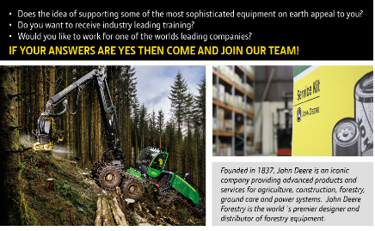
Click here to apply John Deere - Apprenticeship Finder

Slide 5
Click here to apply John Deere - Apprenticeship Finder

Slide 6
EQ is an independent accountancy practice with long established East of Scotland connections, comprising of 17 partners and over 100 staff with offices in Cupar, Dundee, Forfar and Glenrothes. Modern and energetic, we are one of the 15 largest accountancy and business advisory practices in Scotland and a leader in our field. We are also part of Kreston International, a global network of independent accountancy firms operating in over 125 countries, which allows us to provide national and international services to our clients.

Slide 7
As a modern, energetic accounting practice, we aim to provide a working environment that is inspiring, encouraging, friendly and supportive.
We currently have exciting entry level positions available for you to join our vibrant, growing accountancy practice. Renowned for our professionalism and providing clients with a high-quality service, we are looking to strengthen our team by recruiting Trainee Accounts Assistants in our Dundee, Forfar and Glenrothes offices.

Slide 8
During your initial stages of training you will be assisting with compliance work (i.e. accounts and tax return completion) but, as your experience grows, invariably your exposure to different types of work and clients will increase as will your level of responsibility. To equip you to deal with this, appropriate training and supervision will be provided.

Slide 9
The Candidate
• You will have (or be expecting) good grades at Higher level (or equivalent), including Maths and English
• Excellent organisational and communication skills
• A pro-active approach to work and learning
• Great customer service skills
• A love for numbers and problem-solving
How do I apply?
Please apply through the careers section on our website, where you can also see what it’s like to train with us by reading our current and past Trainee staff profiles. .
Click on the link to apply Vacancies Archive - EQ Accountants

Slide 10
Medic Insights Dundee
student-led society at the University of Dundee that provides school pupils from Tayside, Perth & Kinross, Angus and Fife with an insight into a career in medicine and other healthcare specialties.
We will be hosting our S4 day on Saturday 20th March 2021 from 10:15am to 4pm. This event is for current S4 pupils who are interested in studying medicine at university and will be held on an online platform.

Slide 11
Medic Insights Dundee
To apply, fill out the survey below:
https://dundee.onlinesurveys.ac.uk/mi-2021-s4-application <https://dundee.onlinesurveys.ac.uk/mi-2021-s4-application?fbclid=IwAR2Hy1dBjH--RWDdoAS7vc4ltQ5HX96FO2cR6Qhw6vJJl2J6vnwehoxzNtQ

Slide 12
Leaving school soon? Want to get industry ready? The DYW Skills Academy is for you. Our ‘Get Industry Ready’ sessions give you the insight, skills and knowledge you need to build your industry readiness. Our video content delivered by industry experts is open to everyone. We also have bite sized e-learning, virtual mock interviews and CV checks by an employers on offer. Interested? Click on the links in the following four slides for access to a variety of interesting and informative video content and be inspired

Slide 13
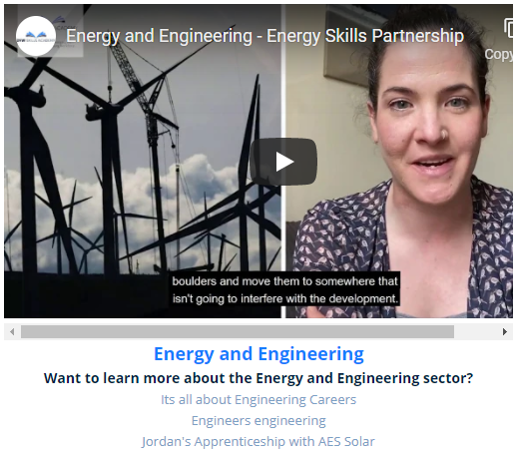
Industry Insights - DYW – Scotland

Slide 14
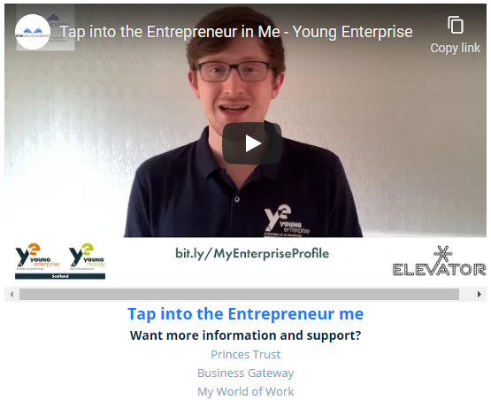
Watch the ​Videos (dyw.scot)

Slide 15
Find out more (dyw.scot)

Slide 16
Find out more (dyw.scot)

Slide 17
Explore the Young People sections on the DYW Website to start to develop your own future. Find out More (dyw.scot)

